Slide 1
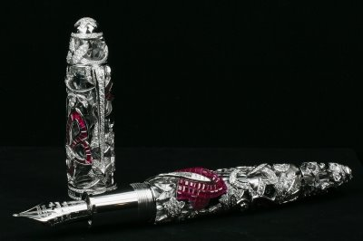
Ink Analysis

Slide 2
There are pens, and then there are writing instruments. This instrument is the world's most expensive ballpoint pen with 840 diamonds and 20 carats in gemstones. It's made by Mont Blanc and Van Cleef & Arpels. Each pen takes one and a half years to make, and only nine will me made. Each pen will cost $730,000.

Slide 3
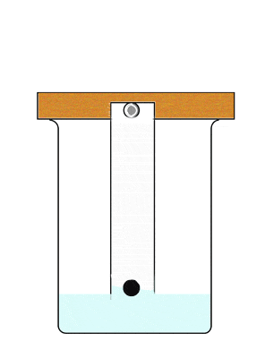
As we learned, ink can be analyzed by…
Chromatography
Most commercial
inks contain
several dyes

Slide 4
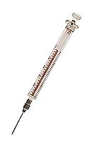
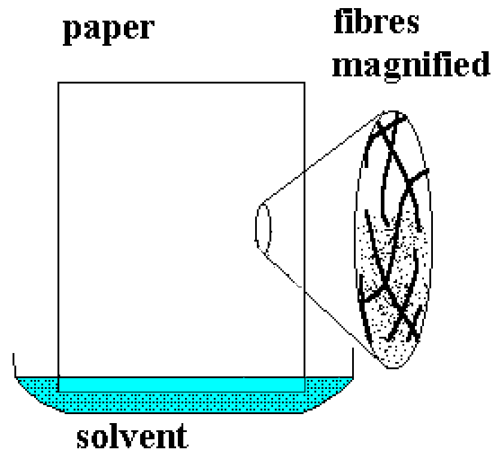
How is ink removed from a questioned document for chromatographic analysis?
Needle punches out a ink samples from the paper
~1o plugs are sufficient

Slide 5
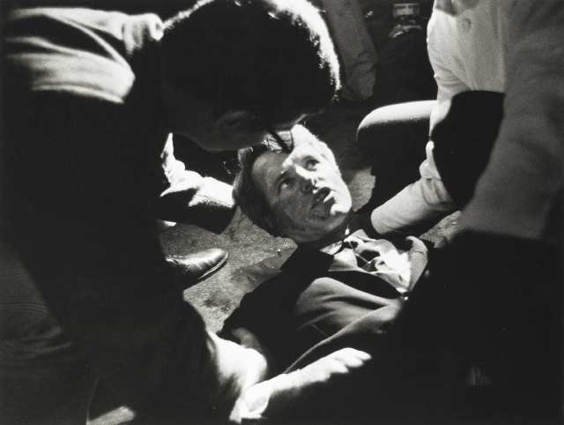

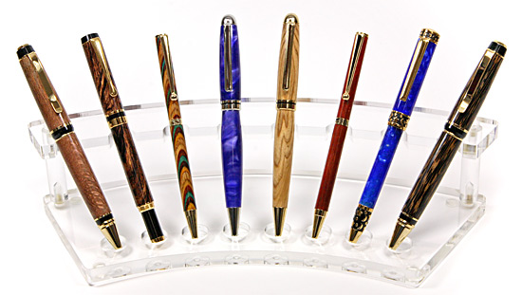
Since 1968, the US Treasury Dept has been cataloging all pen inks
Based on dye-patterns of chromatography
Useful for fraud cases

Slide 6
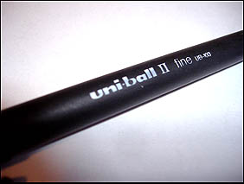
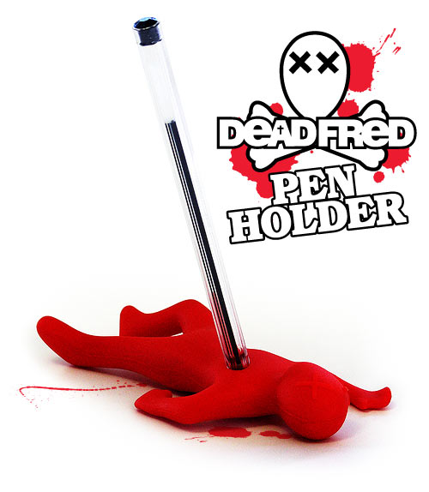
Several Ink manufacturers have been…
Voluntarily tagging their inks
The companies change their ink tags every year
Journal Article:
Analysis of Indian blue ballpoint pen inks tagged with rare-earth thenoyltrifluoroacetonates by inductively coupled plasma–mass spectrometry and instrumental neutron activation analysis
S.D. Mainda, S.A. Kumarb, N. Chattopadhyaya, Ch. Gandhic, M. Sudersananb
Received 3 January 2005; received in revised form 6 May 2005; accepted 23 May 2005. published online 05 August 2005.

